Slide 2
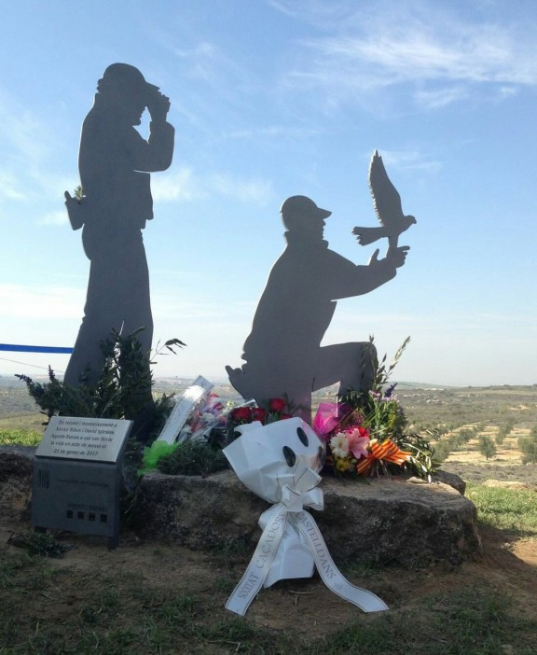
Notes:
Xavier Ribes i David Iglesias

Slide 3
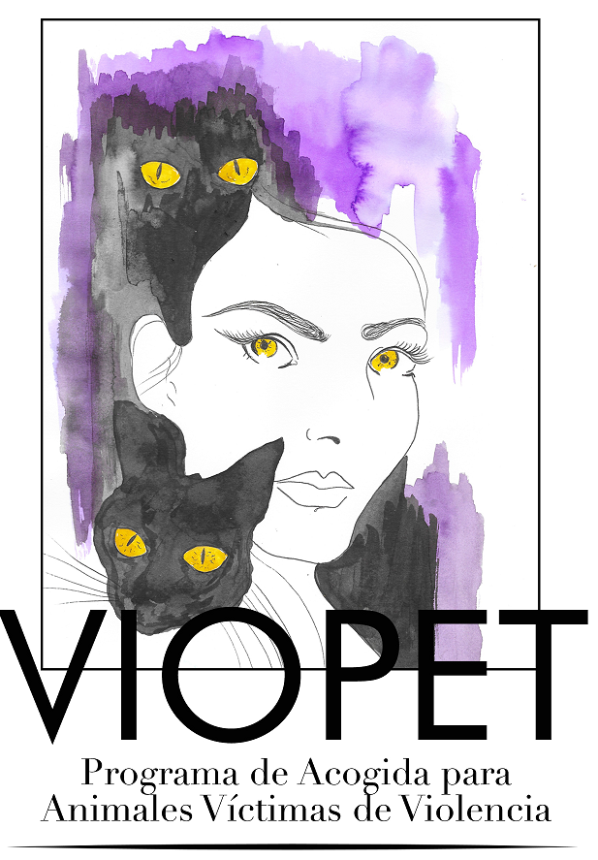
VIOLENCIA HACIA LOS ANIMALES Y VIOLENCIA INTERPERSONAL, IMPLICACIONES SOCIALES Y CRIMINOLÓGICAS
DRA NÚRIA QUEROL VIÑAS

Slide 4
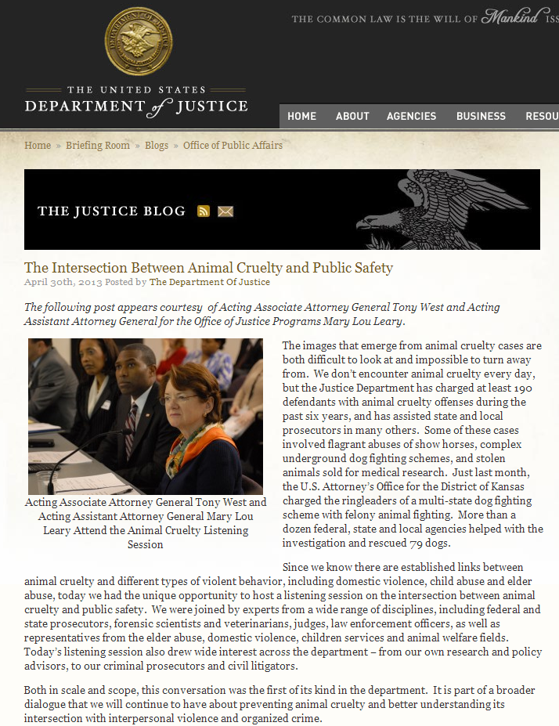

Slide 6
Maltrato a animales
Class A felony – Delitos violentos/Contra la sociedad (asesinato, arson, lesiones)

Slide 7
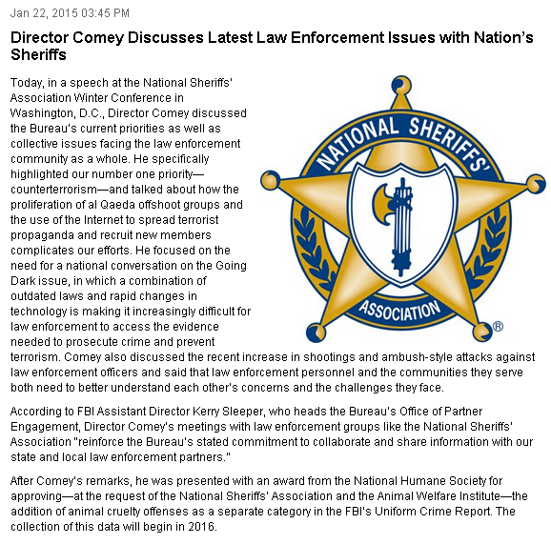

Slide 8
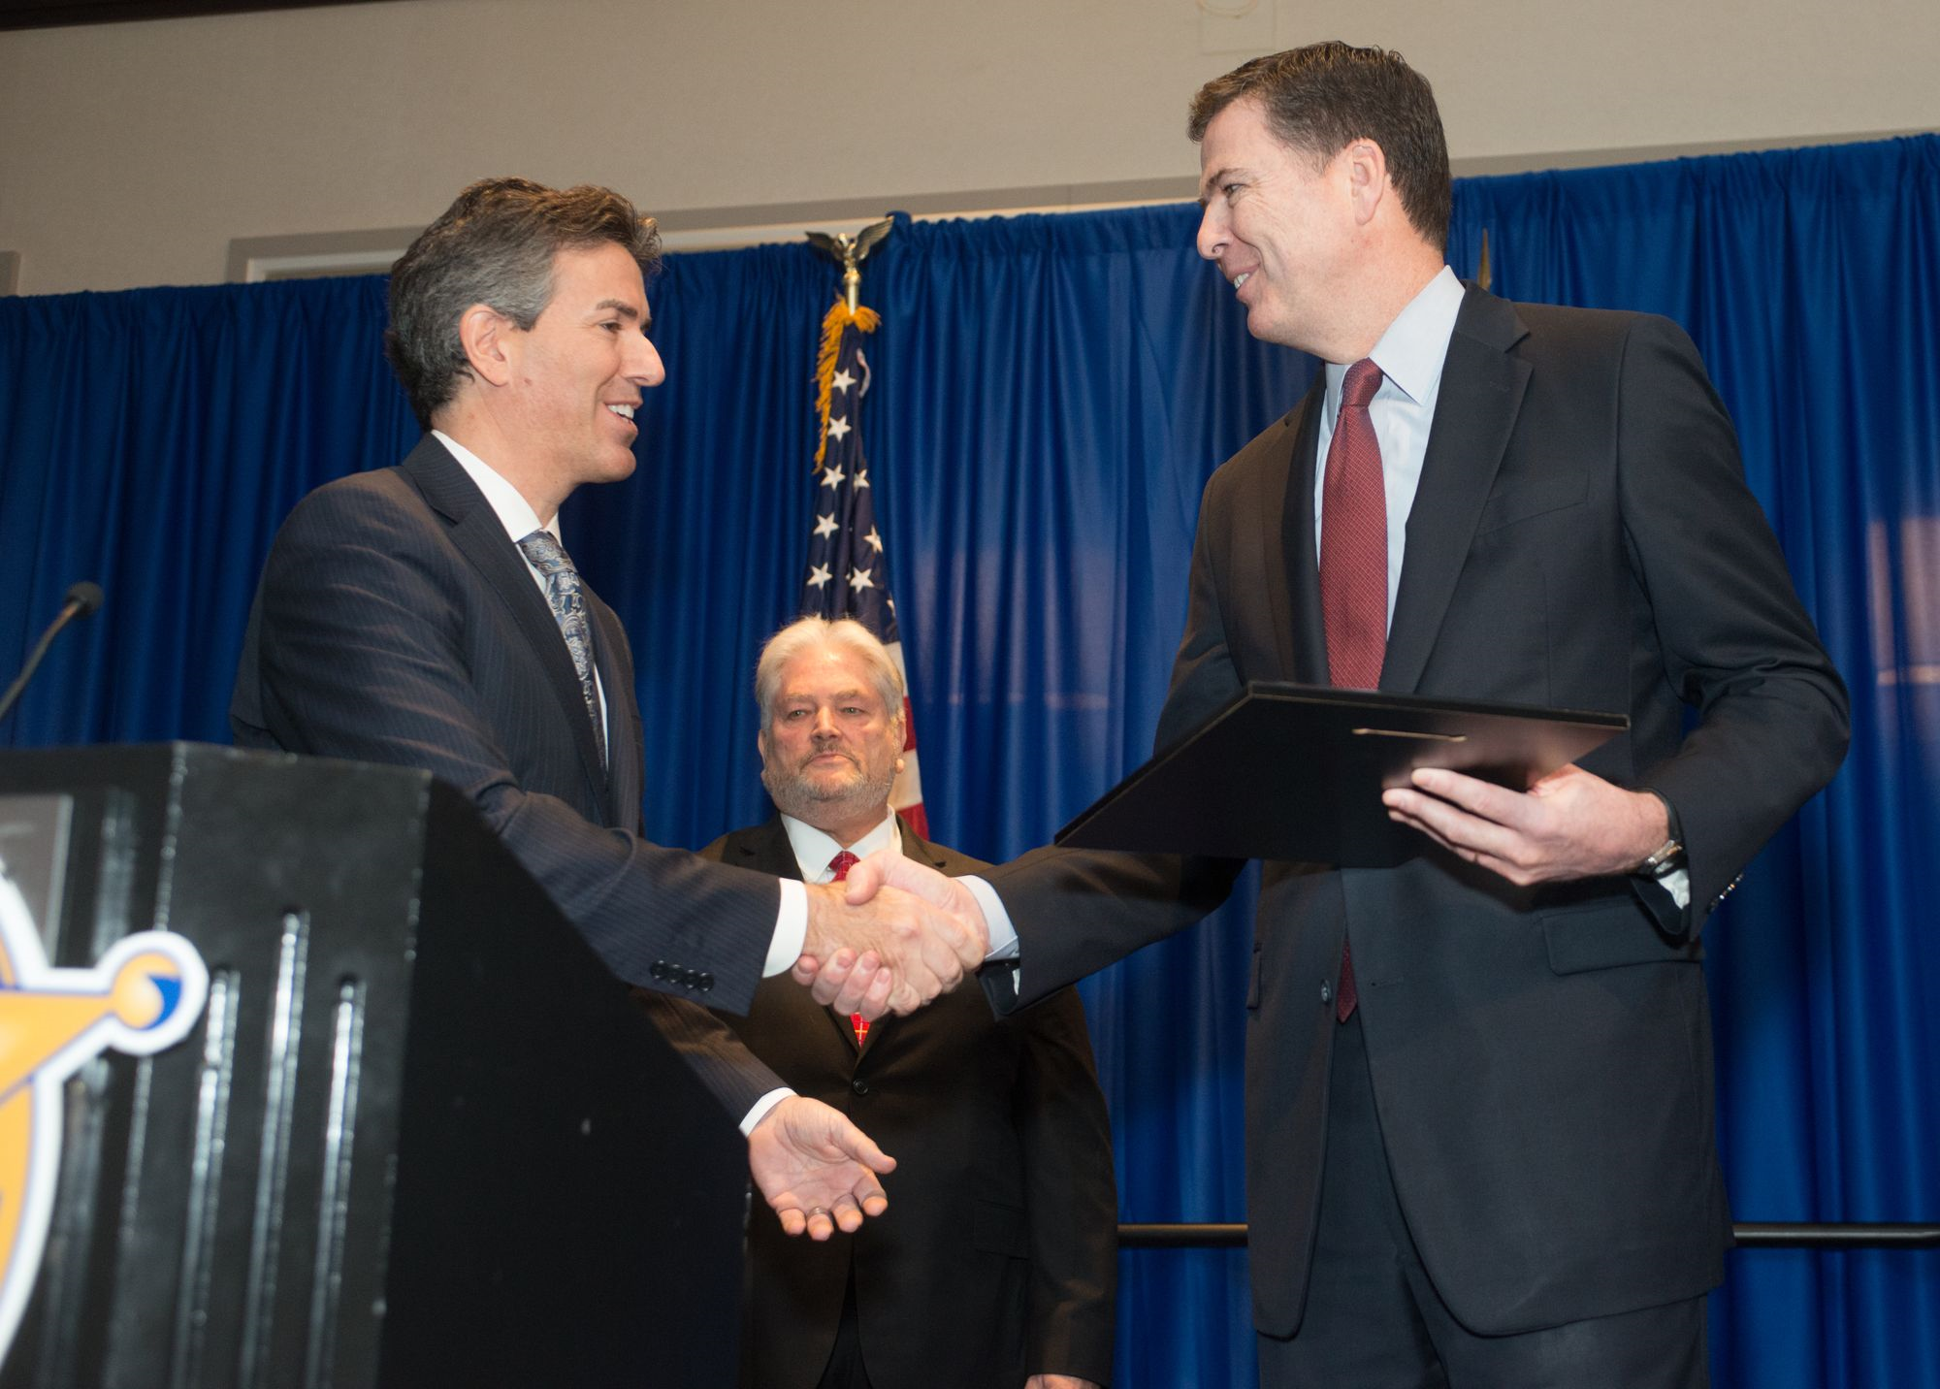

Slide 9
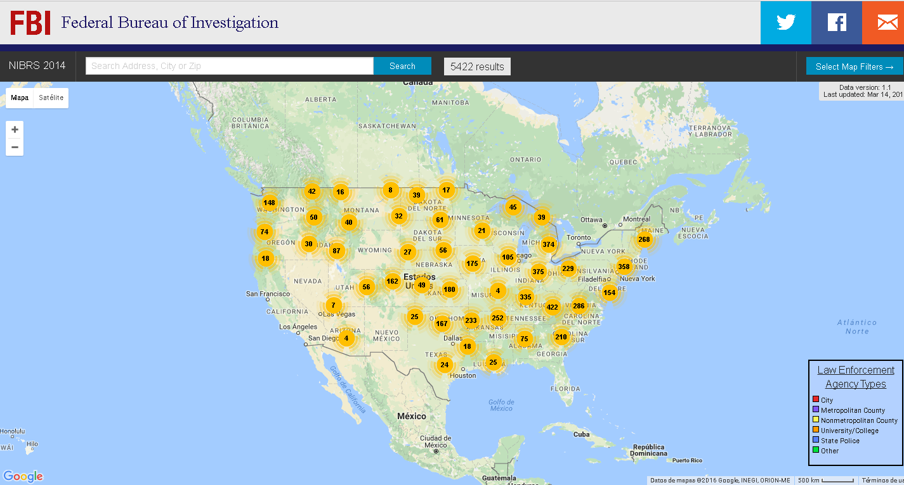

Slide 10
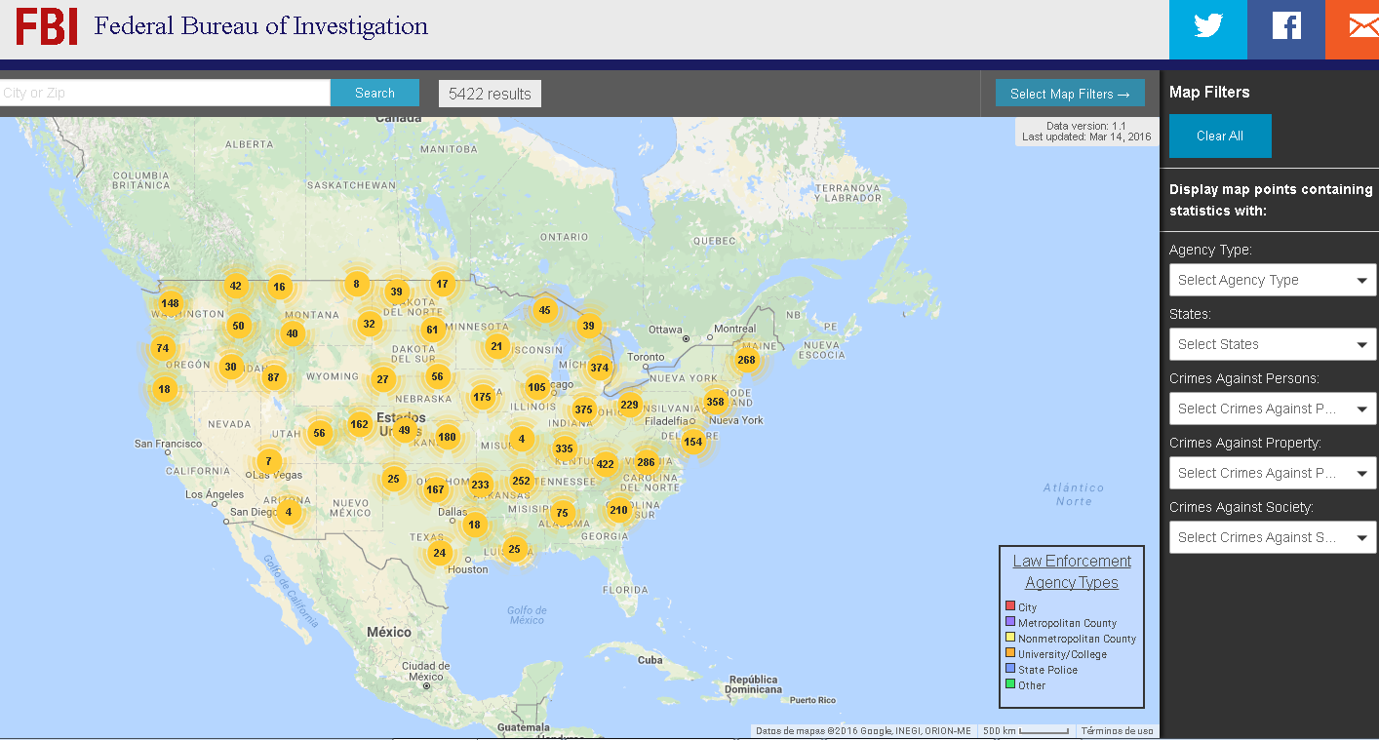

Slide 11
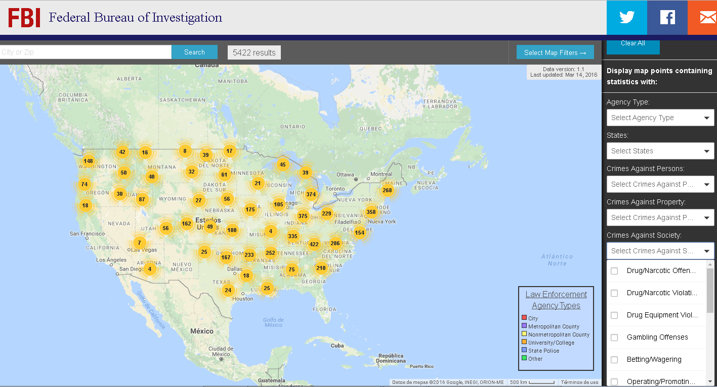

Slide 12
Grupo de trabajo maltrato animal NIBRS – FBI/NSA

Slide 13
VIP Y MALTRATO A ANIMALES

Slide 15
Kayla Bourque
23 años
Estudiante Criminología
Adoptada a los 9 años de un orfanato de Rumanía
Mató al perro y gato de su familia
Explica a compañeros que mata y desmiembra animales (gatos del campus)

Slide 16
Fantasea sobre matar personas sin hogar con pistola
Mental Health Act- Orden de Registro
Kill kit: bolsa de deporte con cuchillo, hoja de afeitar, 3 bolsas grandes de plástico, aguja hipodérmica y una máscara
Vídeo de muerte del perro de la familia
Vídeo torturando y matando al gato de la familia
Pornografía infantil
Notes:
blue nylon bag with a kitchen knife, a razor blade, three large garbage bags, a hypodermic needle and a mask.

Slide 17
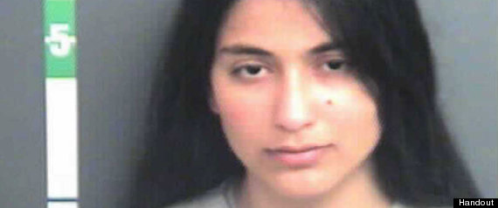
Dx: trastorno sádico personalidad, T. narcisista, ASPD, tendencia a psicopatía (PCL Hare)
Notes:
sexual sadist and narcissist with an anti-social personality disorder and sociopathic tendencies.

Slide 19
MALTRATO ANIMAL Y MENORES ¿COSAS DE NIÑOS?

Slide 20
“La ardilla que matas en broma, muere en serio.
Henry David Thoreau

Slide 21
Maltrato animal- proscrito por vía penal y administrativa
ART 337 DEL CP

Slide 22
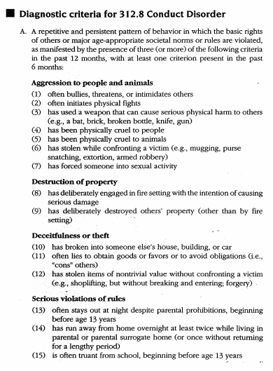
T. DISOCIAL Y MALTRATO A ANIMALES
DSM IV

Slide 23
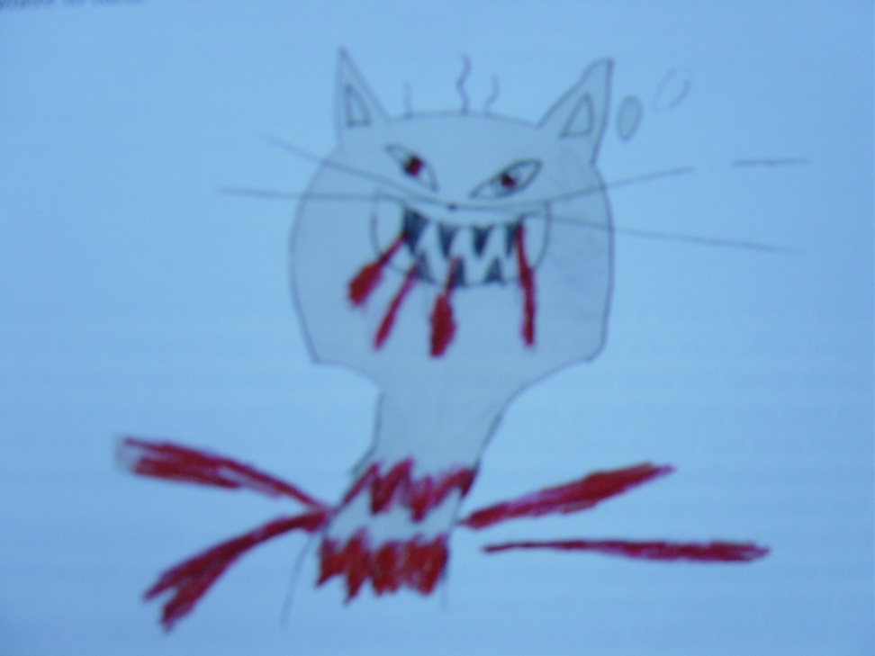
T. disocial
Uno de los síntomas más precoces (6.75años)
Inicio temprano-> peor prognosis
>Prob síntomas + severos

Slide 24
Antecedentes crueldad hacia animales y abusos sexuales

Slide 25
MALTRATO ANIMAL Y CRIMINALIDAD VIOLENTA

Slide 26
Notes:
A 1997 study conducted by Northeastern University and the Massachusetts Society for the Prevention of Cruelty to Animals found that over a 20 year period, a group of 153 animal abusers were five times more likely to commit violent crimes, four times more likely to commit property crimes, and three times more likely to have drug or disorderly conduct offenses than a matched group of 153 non-animal abusers.
In a study of men imprisoned for violent crimes versus a group of non-incarcerated, nonviolent individuals, 25% of the violent criminals reported "substantial cruelty" towards animals in their childhood, while none of the non-incarcerated men reported a history of animal cruelty.
In a similar study of assaultive women offenders, 36% reported a history of animal abuse compared to none of the non-assaultive women.
In a study of 53 families being treated for incidents of child abuse, 60% also abused animals. In two-thirds of the cases, it was the abusive parent who had killed or injured the animals to control a child. In one-third, the children had abused the animals, using them as scapegoats for their anger.
In a study of 28 incarcerated sexual-homicide perpetrators (all men), researchers found that 36% had abused animals in their childhood and 46% in adolescence.
In a study using a sample of 64 men, 48% of convicted rapists and 30% of convicted child molesters reported cruelty to animals during their childhood or adolescence.
En estudios comparativos se ha visto una mayor incidencia de antecedentes de abuso a animales siendo niños en presidiarios por crimen violento respecto a un grupo de hombres no violentos no encarcelados (Kellert & Felthous, 1985, entre otros trabajos). Se encontraron también antecedentes de crueldad con animales en exhibicionistas (30%), acosadores sexuales (36%), acosadores sexuales encarcelados (46%), violadores convictos (48%) y asesinos adultos (58%) (Ascione, 1993

Slide 29
Estudio de la Northeastern University y the Massachusetts Society for the Prevention of Cruelty to Animals (1997) durante 20 años: grupo de 153 maltratadores de animales
5 veces más probabilidad de cometer crímenes violentos
4 veces más probabilidad de cometer crímenes contra la propiedad
3 veces más probabilidad de cometer faltas y consumir drogas
que un grupo de 153 no maltratadores de animales

Slide 30
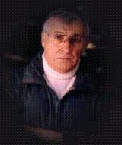
ASESINOS EN SERIE Y DE MASAS
“Un asesino en serie es un niño que no aprendió que sacarle los ojos a un cachorro estaba mal...”
Robert K. Ressler

Slide 31
Ressler, R.K., Burgess, A.W., & Douglas, J.E. (1988). Sexual Homicide: Patterns and Motives. Lexington, MA: Lexington Books.
Study based on male homicide perpetrators whose offenses also included some form of sexual crime, 36% of offenders were violent to animals in childhood, 46% in adolescence, and 36% in adulthood based on self-report measures

Slide 32
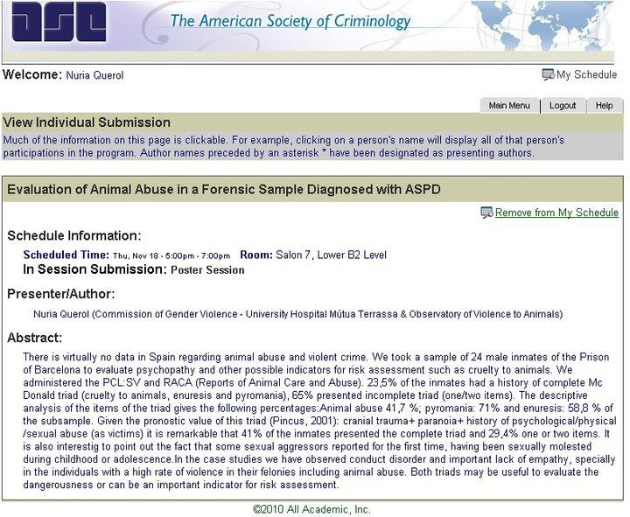

Slide 33
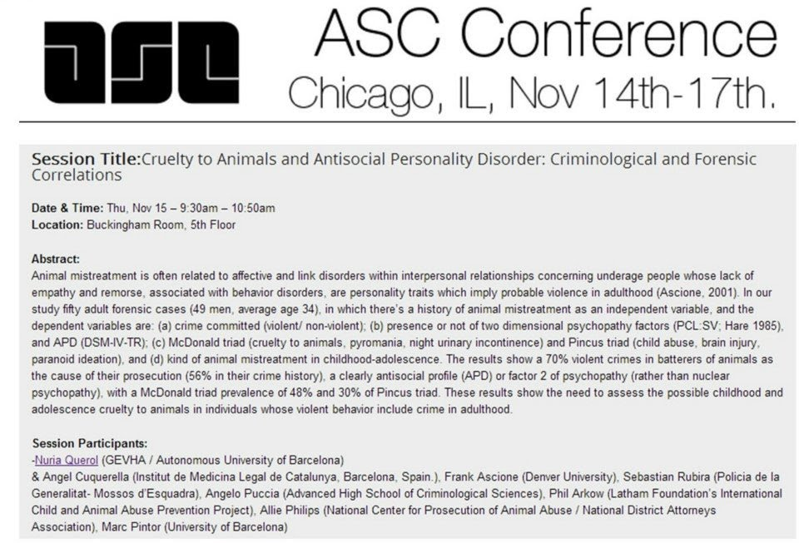

Slide 34
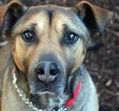
Of the sample of 52 cases with a history of animal abuse, the cause for their prosecution is a violent crime (89%)
They have a previous history of violent offending (77%)
Notes:
89% violent crimes in batterers of animals as the cause of their prosecution

Slide 35
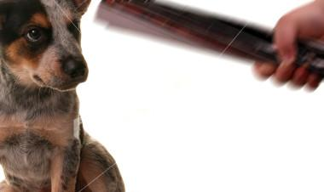
High scores in psychopathy and ASPD related to more sadistic animal abuse and more sadistic interpersonal violence.

Slide 36
ALGUNOS CASOS DE SERIAL KILLERS

Slide 37
Albert de Salvo (El estrangulador de Boston)
Mató a 13 mujeres en 1962-3, pero fue sentenciado a cadena perpetua por robo armado, asalto y delitos sexuales hacia 4 mujeres. Cuando era joven, atrapaba gatos y perros en jaulas y se divertía lanzándoles flechas a través de las rejas
Notes:
La observación de que el abuso a animales está relacionado con la violencia social está comprobado por pruebas científicas. Los investigadores han visto que el abuso a animales en la niñez/adolescencia a menudo precede a crímenes violentos. La mayoría de los asesinos en serie como Jeffrey Dahmer o Albert de Salvo cometían atroces torturas a animales. Algunos criminales aseguran que dañar animales aumenta su hostilidad o es una manera de impresionar a otros con su “dureza”.

Slide 38
Henry Lee Lucas A los 13 años empezó a capturar animales que luego violaba, torturaba y asesinaba. Piquering. Mató a más de 100 personas por toda USA
Notes:
Antes de15 or 20 from Salt Lake City animal shelters over the next 13 months, using them as surrogates for children. “It was so stimulating,” he later told Detective Don Bell (quoted in the Deseret News). “A puppy whines just like Alonzo did. I would get frustrated at the whining. I would hit them with hammers or drown them or strangle them.”

Slide 39
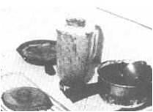
Richard Trenton Chase (el Vampiro de Sacramento) De niño prendía fuegos y torturaba animales. Con 10 años, mataba gatos.Mataba y descuartizaba conejos para comerlos crudos Preparaba brebajes: sangre e intestinos de conejo (evitar que su corazón encogiera). Se inyectó sangre de conejo
Notes:
Born May 23, 1950, he liked to set fires as a child and to torment animals. By the time Richard was ten, he was killing cats. As a teenager, he drank and smoked dope, getting into trouble several times but showing no shame over it
He was preoccupied with any sign that something was wrong with him, which held true throughout his adult life, and he once entered an emergency room looking for the person who had stolen his pulmonary artery. He also complained that the bones were coming out through the back of his head, that his stomach was backwards, and that his heart often stopped beating. Another psychiatrist diagnosed him as a paranoid schizophrenic, but thought he might actually be suffering from a drug-induced toxic psychosis. Chase soon began to kill and disembowel rabbits that he either caught or bought, and to eat their entrails raw. Sometimes he would put the intestines with the animal’s blood into a blender, liquefy them, and drink this concoction in an effort to keep his heart from shrinking to the point of disappearing from his body. He once injected rabbit blood into his veins and got very ill. He believed this rabbit had ingested battery acid that had seeped into his stomach, but in fact he had a bad case of blood poisoning.
Chase moved into another apartment and began to catch and torture cats, dogs, and rabbits. He killed them to drink their blood. Sometimes he stole neighborhood pets, and he once even called a family whose dog was missing to tell them what he had done to the animal. He bought guns and started to practice with them.

Slide 40
Condenado por dos asesinatos (sospechoso de más de 40). De niño veía a su padre torturar animales. Él empezó a imitarle.
Theodor Robert Bundy

Slide 41
ÁREAS A EVALUAR
Competencia / Desarrollo
funcionamiento cognitivo, habilidades sociales, comunicación, la capacidad de recuperación, la autoestima y la autocompetencia.
Drogas y alcohol
La evidencia de abuso de sustancias patrón y su relación con delito actual
Antecedentes penales / policiales
Agresión a personas y animales, patrones de conducta antisociales, violaciones normativas graves. Agresiones sexuales. Parafilias.

Slide 42
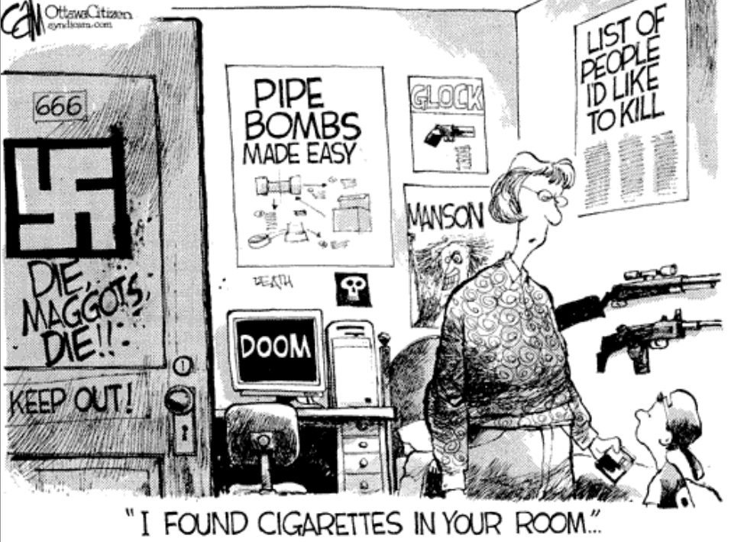

Slide 43
Características del maltrato
Naturaleza, frecuencia, gravedad y alcance de la conducta.
- Conciencia del impacto a víctima /empatía
Historia vital/desarrollo

Slide 44
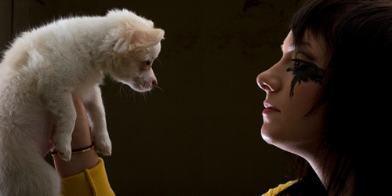
VIOLENCIA DE PAREJA Y MALTRATO A ANIMALES

Slide 45
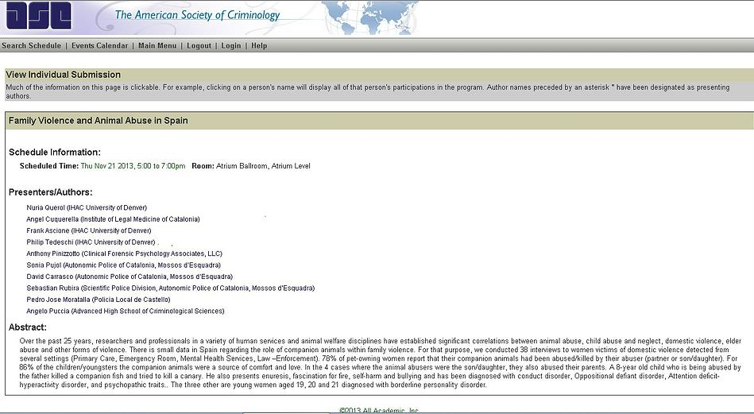

Slide 46
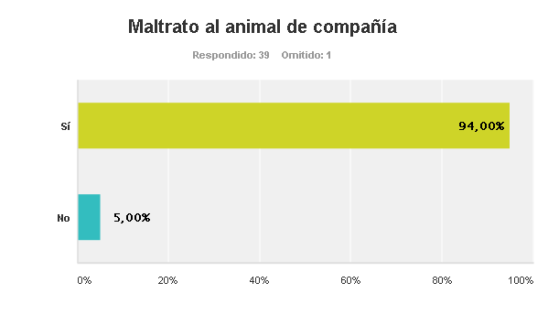

Slide 47
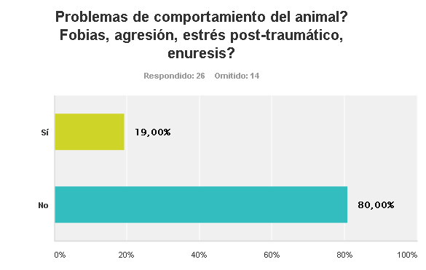

Slide 48
INDICADORES Y RISK ASSESSMENT

Slide 50
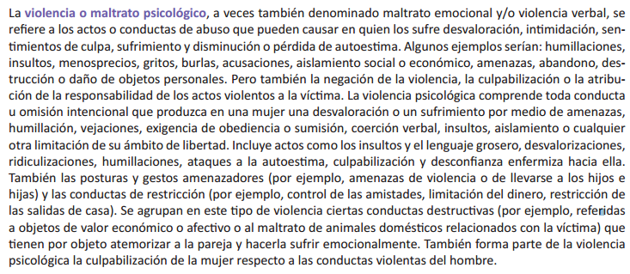

Slide 51
http://viopet.org/
Indicadores
¿Qué Hacer?
Medidas de Autoprotección

Slide 52
Las protectoras colaboradoras ofrecen acogida a los animales de víctimas de violencia
Apoyo del Ayuntamiento de BCN, Comisiones Municipales de VD y Cuerpos Policiales

Slide 53
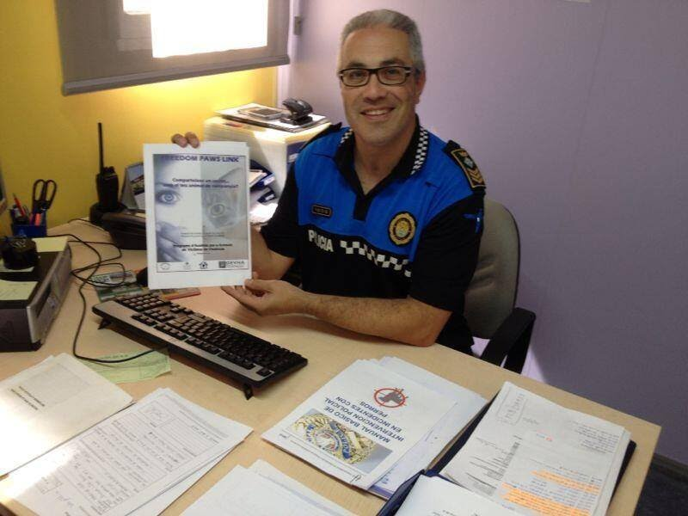
Policia Local de Polinyà
UPROMA (Policia Local de Castelló)
PL Fuenlabrada
PL Torres de la Alameda
Mossos d’Esquadra
Colaboración con:
CNP, GC
PL Sevilla
PL Alcantarilla

Slide 54
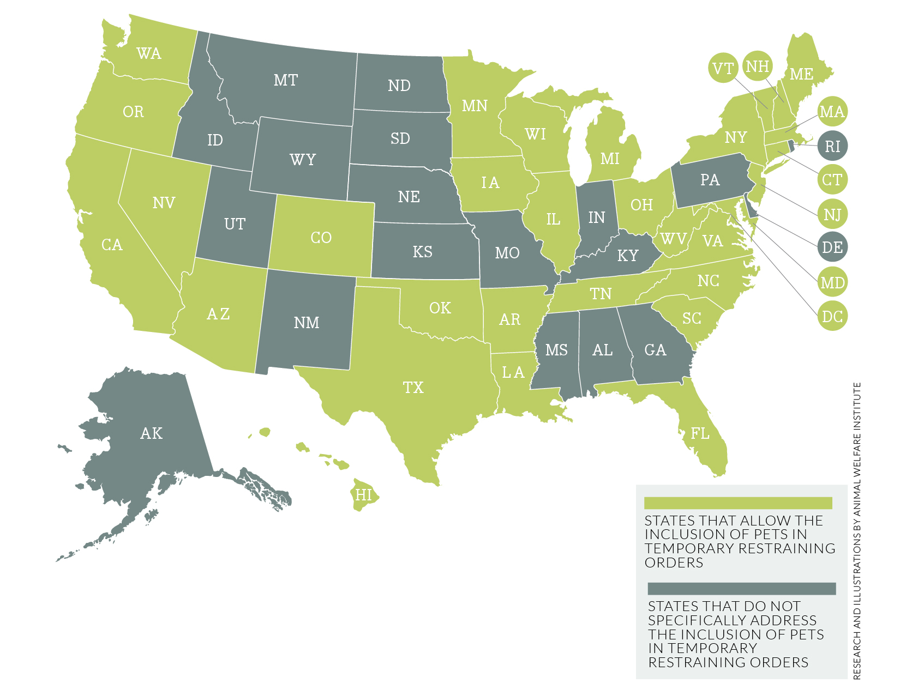
Animales de compañía en las órdenes de alejamiento en VG en 31 Estados, DC y PR en USA
Conceptos

Slide 55
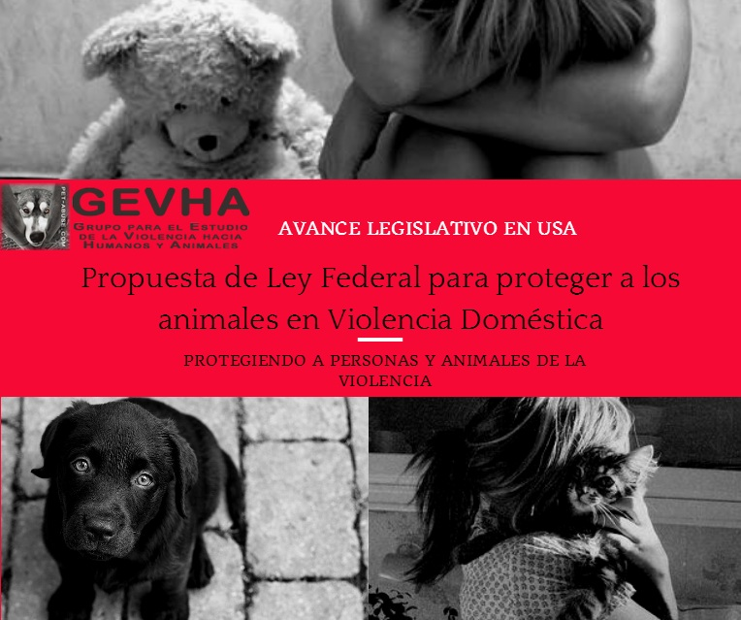
PROPUESTA A NIVEL FEDERAL
Proyecto de Ley Pet and Women Safety (PAWS) Act (H.R. 5267)

Slide 57
CASO CASCANTE
GUARDERIO FORESTAL, NAVARRA

Slide 60
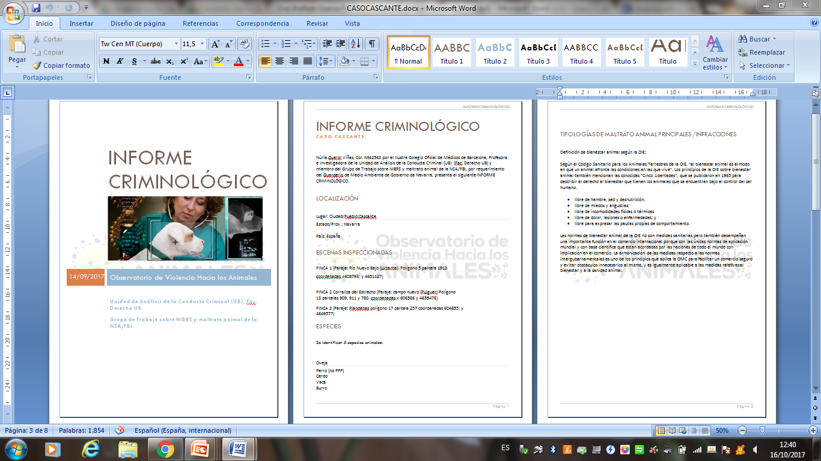

Slide 61
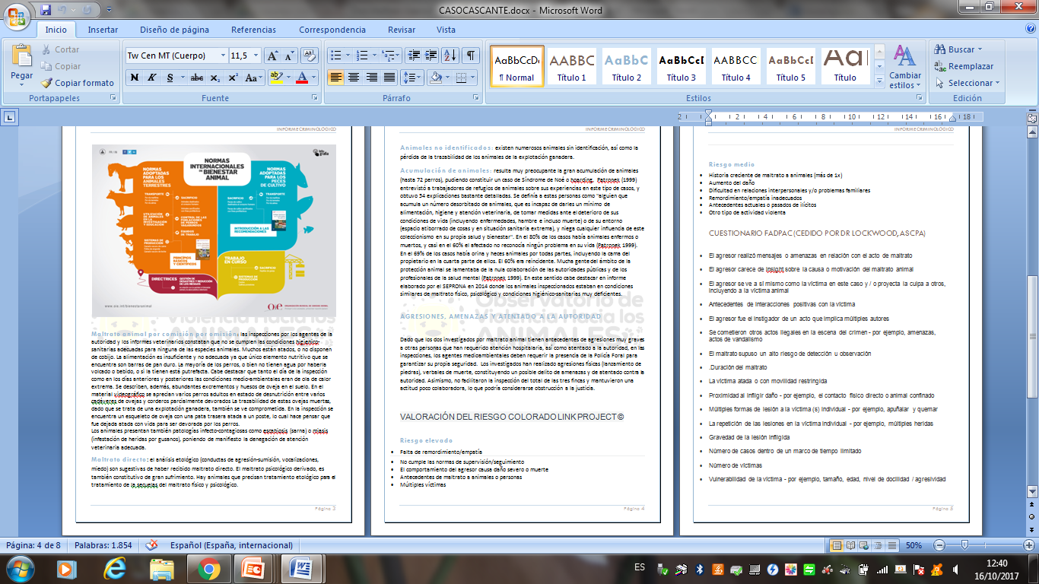

Slide 63
Kayla…

Slide 64
-Condenada por maltrato a animales
Condenada por posesión de armas con intención peligrosa
Prohibición visitas 6pm-6am
Obligatoriedad de informar a visitantes
Prohibición de trato con menores
Prohibición de acceso a internet
Prohibición de posesión de agujas, cuchillos y cinta aislante
Supervisión permanente
Notes:
Under the conditions, Bourque is not allowed to have anyone in her home from 6 p.m. to 6 a.m., and anyone who does visit must be made fully aware of the charges she pleaded guilty to and their circumstances.
She can't associate with anyone under age 18 or access the internet. She is also banned from possessing duct tape, hypodermic needles or knives.
O'Shaughnessy says the tough probation conditions and the very public warning may actually make Bourque more inclined to act out.
“That warning may also carry with it a big risk — that it may in fact provoke her further, and may ostracize her from others and may in fact make her more alienated and angry and wanting to act out in an aggressive or violent way,” he said.
Bourque was adopted as an orphan from Romania at eight months old and grew up in Prince George, B.C.
Bourque was sentenced to one month in jail on each of the charges, but had already spent six months in custody by the time she was sentenced.
She was ordered to serve an additional two months in custody, in part so probation officials could prepare for her highly supervised release, and will now live in Vancouver.
Bourque is:

Slide 65
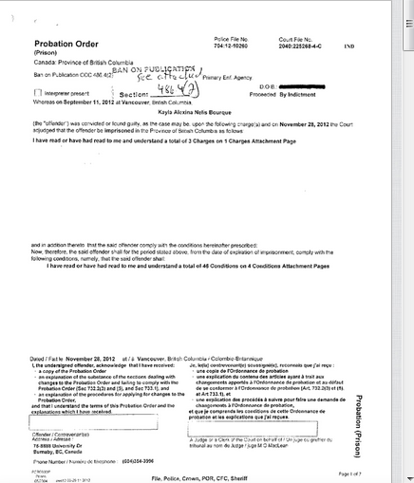

Slide 66
“Educando a los niños a no dañar a las mariposas, ayudamos tanto a los niños como a las mariposas”
Notes:
66

Slide 67
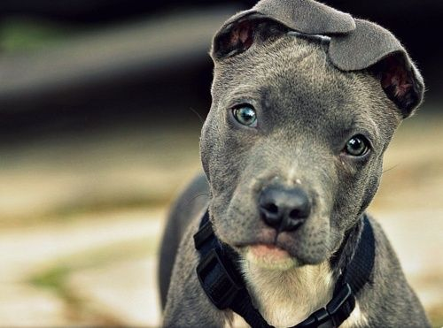
MUCHAS GRACIAS!
Obsviolenciaanimal.org
viopet.org
info@viopet.org
dra.querol@viopet.org
viopet112

